Slide 1
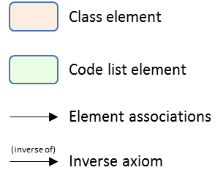
Procurement Procedure
In any Procurement Procedure, there is at least one Procuring Entity.
In some Procurement Procedures, it can join other Procuring Entities (Joint Procurement).
In these cases, the Procuring Entities may adopt different roles (Procuring Entity Role Type code list).
A Procuring Entity may be either a Contracting Authority or Contracting Entity (Procuring Entity Type code list).
Procuring Entities are in general responsible for the purchase, therefore they act as “Buyers”.
This is not always the case: it can rely on or outsource the purchase on a 3rd public or private Buyer (Buyer Role Type code list).
Both Procuring Entities and Buyers are “Organizations” appropriately identified and described (IDs, Names, Addresses, Contact Points, etc.).
Organization
Is a
Is a
Procuring Entity
Buys through a
(buys on behalf of)
Buyer
Joint procurement
Procuring Entity Type: Contracting Authority, Contracting Entity
Buyer Role Type: Central Purchasing Body, Buyer on behalf of other procuring entities, outsourced procuring party
Procuring Entity Role Type: Joint Procurement Member, Joint Procurement Lead

Slide 2
Procurement Procedure
Any Procurement Procedure refers always to at least one Economic Operator.
For some Procurement Procedures, Economic Operators form groups (Economic Operator Group), e.g. Consortia, Joint ventures, Undertaking (Group Type code list).
In this case, the Economic Operators of the group play different roles (Economic Operator Role Type code list).
One Economic Operator may rely on 3rd parties; e.g. Economic Operator Subcontracts other Economic Operators.
Economic Operators may be pre-qualified in a national Pre-Qualification System (PQS) “Organization”.
When guarantees are required by the Procuring Entity, Economic Operators may have to provide Financial Account (e.g. a bank account).
Registered Organization
Is a
Is a
Economic Operator
Groups economic operators (is member of)
Economic Operator Group
Has qualifying party
Subcontracts (subcontracted by)
Organization
Economic Operator Role Type: Sole Contractor, Lead Entity, Other Entity
Financial Account
Group Type: Central Consortium, Joint venture, Undertaking
Economic Operator Classification Type: Micro, Small, Medium, SME, Large

Slide 3
Class element
Code list element
Element associations
(inverse of)
Inverse axiom

